Slide 1
My Portfolio Website
Jason Chow

Slide 2
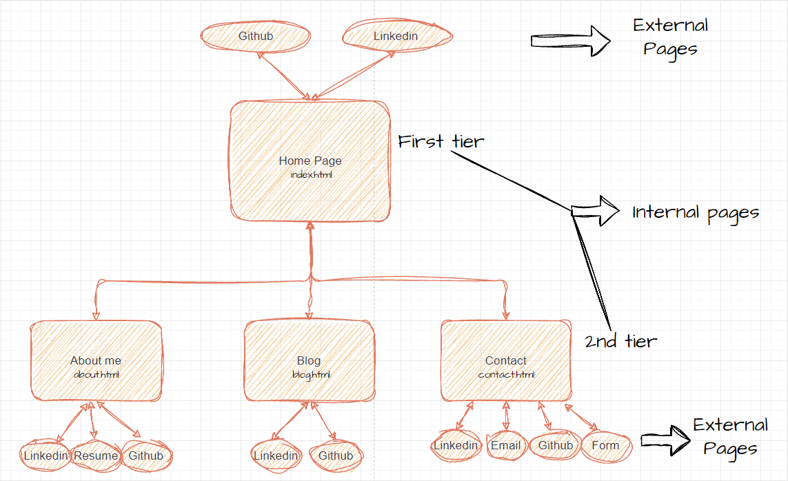
Overview/Sitemap

Slide 3
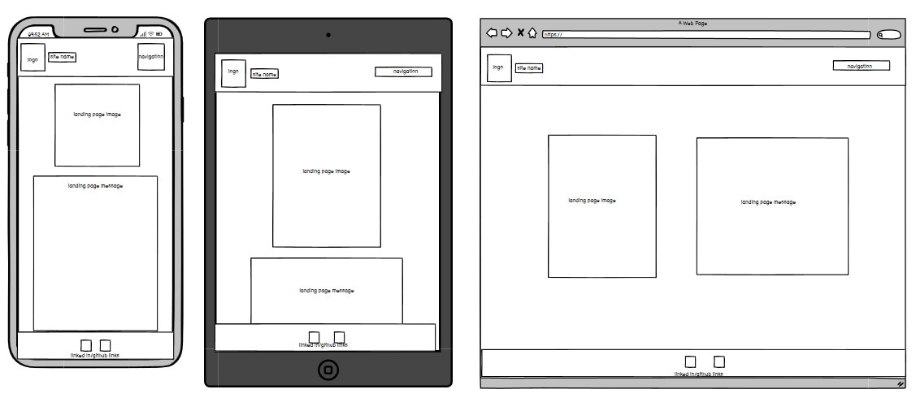
Wireframes

Slide 4
Components
Header component which includes - Navigation Panel with animated icon home button, and links to other website pages.
Footer component - Links to my additional profiles including Github and Linkedin.
A scroll to top feature - Scroll up functionality when clicked.
List of blog articles - Links to blog articles.
Resume - An animated Icon that directs to resume when clicked.
Form component - A contact me details and message section that can be submitted.

